Slide 1
DBMS ACADEMIC PROJECT · REVIEW 1
Bank Transaction System
ACID Compliance, Fraud Detection & Performance Tuning
Design Review Documentation · Team 8
Scope of this Review
Problem Definition & Objectives · Requirement Analysis & Database Design · ER Diagram / Data Model
SQL implementation, stored procedures, triggers, indexing, and experiments are addressed in Review 2 onward.
Relational Database Design Specification for Retail Banking Operations · Prachi Pandurang Raddi (24BDS0389), Sinchana B Kurkuri (24BDS0352)

Slide 2
Problem Definition & Objectives
Problem Statement
Key Design Objectives
Guarantee atomic, consistent, isolated, durable (ACID) fund transfers under concurrent multi-session access
Automatically screen every transaction for suspicious patterns at write-time
Enforce role-differentiated data access for Customer, Teller, Manager, DBA
Support measurable query performance optimization for high-frequency operations
Preserve a complete, immutable audit trail for regulatory traceability
3NF-normalized schema covering all core banking entities with enforced referential integrity
Data model for atomic two-legged fund transfers (debit + credit)
Schema supports concurrent multi-session access (balance, status, timestamps modeled)
Fraud-flagging model for velocity, high-amount, geo/device, odd-hour & round-amount rules
Indexable attributes identified for balance, history & reporting lookups
Role-differentiated access boundaries defined for 4 actor classes
Audit_Log entity for 100% structural coverage of financial-table mutations
Bank Transaction System — Review 1 · Team 8
2

Slide 3
Functional & Non-Functional Requirements
18 Functional Requirements (FR1–FR18)
10 Non-Functional Requirements
Customer & Account Mgmt | Create/update customer records; open, close & change account status
Branch Management | Register branches; branch-level aggregate reporting
Deposits & Withdrawals | Record balance-changing transactions; enforce minimum balance
Fund Transfers | Two linked legs (debit + credit) as one logical, jointly-committable event
Transaction Recording | Every txn permanently logged with reference no., timestamp, channel, balance
Fraud Flagging | Associate transactions with rule-based flags; manager review lifecycle
Loans, Statements, Reports | Loan disbursement; date-range statements; branch/type/month rollups
RBAC | Four actor roles, each restricted to its defined responsibilities
Data Integrity — FKs enforced, no orphaned references
Consistency — no constraint-violating state
Reliability — committed effects survive failure
Security — least-privilege roles; no plaintext sensitive IDs
Performance — low-latency indexable lookups
Scalability — valid from 10Ks to millions of rows
Availability — backup & recovery strategy
Maintainability — 3NF, single-row fact updates
Auditability — actor, timestamp, before/after value
Grouped by: Customer/Account · Branch · Deposits/Withdrawals · Transfers · Txn Recording · Fraud · Loans/Statements/Reports · RBAC
Bank Transaction System — Review 1 · Team 8
3

Slide 4
Database Design — Main Entities
Entity | Primary Key | Purpose
Branches | branch_id | Branch identity & routing (IFSC code)
Employees | employee_id | Teller / Manager / DBA, scoped to a branch
Customers | customer_id | Account holder identity & KYC status
Account_Types | account_type_id | Interest rate & min balance per category
Accounts | account_id | Hub entity — balance, status, owner, branch, type
Transactions | transaction_id | Central fact table — every deposit/withdrawal/transfer leg
Loans | loan_id | Principal, rate, tenure, status per account
Fraud_Flags | flag_id | Rule-triggered alerts with reviewable lifecycle
Audit_Log | audit_id | Append-only before/after trail of financial mutations
Bank Transaction System — Review 1 · Team 8
4

Slide 5
Relationships & Cardinalities
Entity 1 | Relationship | Entity 2 | Cardinality
Branches | operates | Employees | 1 : N
Branches | hosts | Accounts | 1 : N
Customers | owns | Accounts | 1 : N
Account_Types | categorizes | Accounts | 1 : N
Accounts | generates | Transactions | 1 : N
Accounts | is counterparty of (related_account_id) | Transactions | 1 : N (self-ref.)
Employees | processes | Transactions | 1 : N (optional)
Accounts | secures | Loans | 1 : N
Transactions | raises | Fraud_Flags | 1 : N
Employees | reviews (reviewed_by) | Fraud_Flags | 1 : N (optional)
All financial tables | is recorded in | Audit_Log | 1 : N (logical, not FK)
Bank Transaction System — Review 1 · Team 8
5

Slide 6
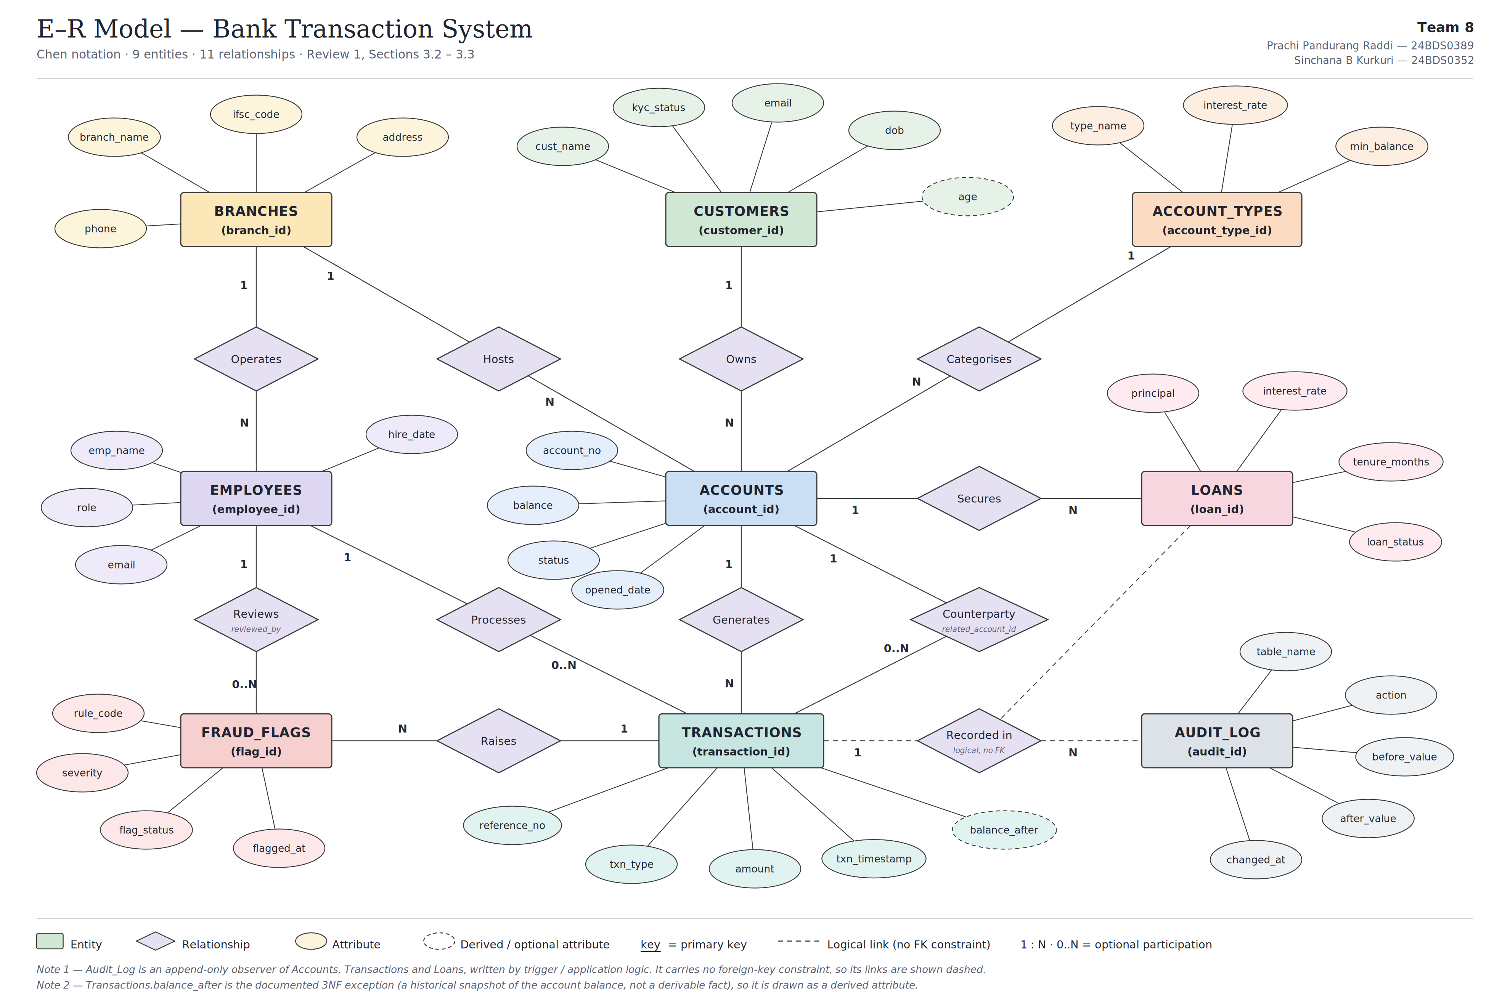
ER Diagram
Reading the Model
Accounts is the hub: 1 Customer, 1 Branch, 1 Account_Type per account
Transactions self-references Accounts via related_account_id (transfer legs)
Employees plays two roles: processes Transactions, reviews Fraud_Flags
Loans and Fraud_Flags each depend on exactly one parent (Accounts, Transactions)
Audit_Log is a logical, non-FK observer of Accounts/Transactions/Loans
Audit_Log
(append-only, no FK)
Bank Transaction System — Review 1 · Team 8
6

Slide 7
Normalization — 3NF
1NF
2NF
3NF
Every attribute holds a single atomic value
No repeating groups (e.g., role is a single ENUM, not a list)
Every table has a defined primary key
1NF satisfied
Every non-key attribute depends on the whole PK
All tables use single-column surrogate keys — partial dependency is structurally impossible
2NF satisfied; no transitive dependency
Branch facts stay in Branches; not copied into Accounts
Account_Types.interest_rate stays in Account_Types, not per-account
Transactions.balance_after is a documented exception — a historical snapshot, not a live fact
Effect: Branch names, interest rates, and employee details are each stored once and referenced by key — eliminating update, insertion, and deletion anomalies across account and transaction rows.
Bank Transaction System — Review 1 · Team 8
7

Slide 8
REVIEW 1 — DESIGN VALIDATION
Proposed Design Summary
✓
Every FR1–FR18 maps to at least one entity, attribute, or relationship
✓
Nine entities, each with a demonstrable purpose — 2 added beyond the brief, both justified
✓
All relationship cardinalities & participation constraints verified (incl. self-referential & dual-role cases)
✓
Every entity has exactly one surrogate PK; every relationship has a corresponding FK
✓
Design confirmed in Third Normal Form, with a documented exception (balance_after)
✓
ER diagram (Mermaid) matches the relational schema one-to-one
✓
Schema structurally ready to support ACID, fraud detection, concurrency, RBAC, performance & audit work in later phases

